Slide 1

Simulating OSU HTTF PG-28 Test w/ RELAP5-3D
Joshua K Halsted (M.S. candidate, Oregon State University)
Dr. Izabela Gutowska (Facility Owner)
Place logo or company name here
Notes:
Good afternoon everyone, my name is Josh Halsted and I am a Master’s of Science student at Oregon State University, working towards my degree in nuclear engineering. My advisor is Dr. Izabela Gutowska, and today I will be presenting my results for an analysis I performed using RELAP5-3D to simulate a test performed at the OSU High Temperature Test Facility, also known as the HTTF.

Slide 2
Outline
Descriptions
What is the OSU HTTF?
Existing QA-Certified HTTF RELAP5-3D Deck
PG-28 Test
Simulations
Methods
Results
Analysis
Conclusions
Place logo or company name here
Notes:
The first quarter of my presentation will be focused on describing the HTTF, the base input deck developed by Paul Bayless and his team at INL, and the specific test that will be simulated.
I will then go into detail about what I changed in the base deck to capture the initial and boundary conditions specific for the test, the results that were generated, and discuss whether I think this deck properly simulates the physics actually seen in the test facility.

Slide 3
Oregon State University High Temperature Test Facility
What is it?
Notes:
I will start off by briefly describing what the High Temperature Test Facility is.

Slide 4
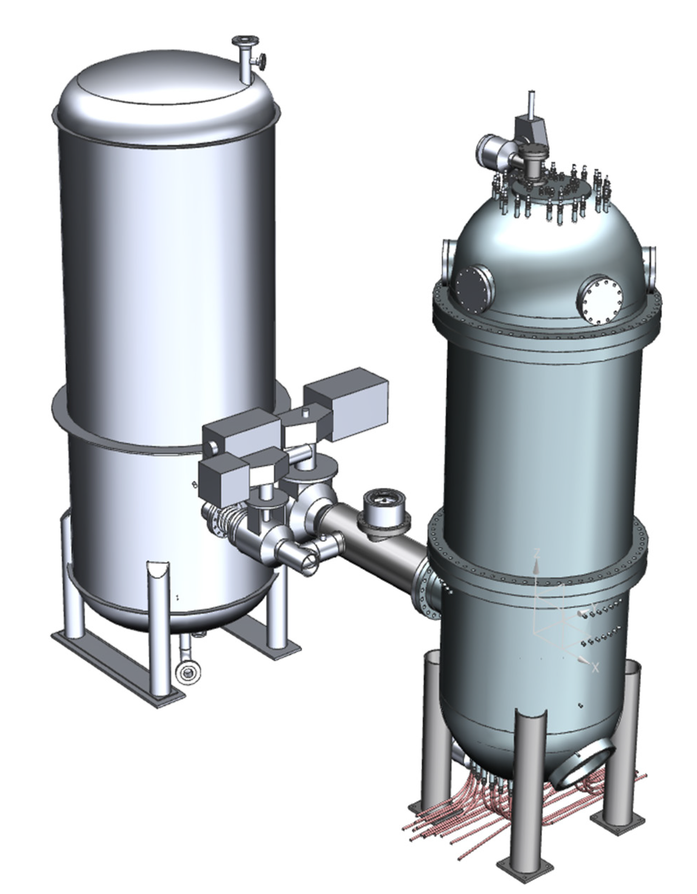
General Description
Integral effects test facility for the General Atomics MHTGR
1/64th in volume, 1/4th in diameter
Utilizes helium as working fluid
Prismatic blocks are heated with dogbone-shaped graphite heaters
Place logo or company name here
Notes:
The OSU HTTF is an integral effects test facility that is scaled to replicate the physics that are hypothesized to occur within the General Atomics Modular High Temperature Gas Reactor. The prototypical MHTGR utilizes helium as the primary coolant fluid and, like many traditional gas reactors, utilizes ceramic, prismatic blocks for both the reflector and power production regions. The OSU HTTF is scaled 1/64th in volume, and a quarter In diameter to the MHTGR. Although it, too, utilizes helium as the primary working fluid, it is capable of utilizing surrogate fluids, and can be retrofitted to test pebble bed geometries.
Whereas in the MHTGR the fuel is embedded into the ceramic in the form of small kernels, the HTTF utilizes dogbone-shaped graphite heaters in columns of 10. The heat transports from the dogbones through a closed helium gap to the ceramic.
A general diagram

Slide 5
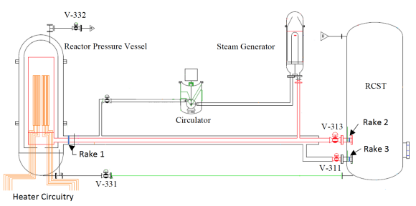
OSU HTTF System Layout
Place logo or company name here
Notes:
This is a simplified diagram of the HTTF, and is the basis for how the RELAP model was developed. Flow enters and exits the reactor pressure vessel through a concentric duct.

Slide 6
Modelling the OSU HTTF w/ RELAP
Paul Bayless’ QA Deck (2018)
Notes:
As previously indicated, a RELAP deck was produced by Paul Bayless and his team in INL, going through the QA process and being put in production in 2018. The next few slides will detail how Paul went about creating the model.

Slide 7
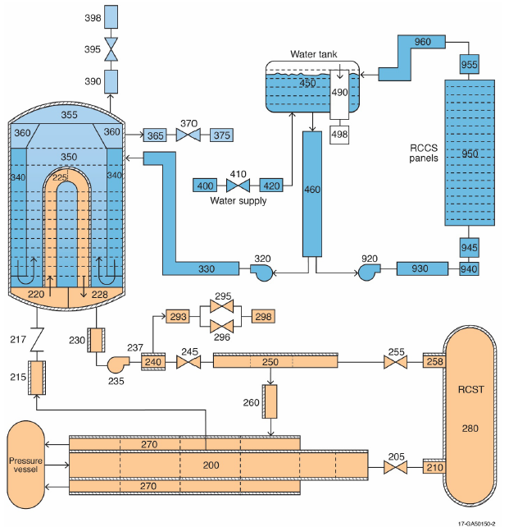
Facility Nodalization
PCS, SCS, and RCCS are implemented
Several simplifications made for PG-28 simulation
Replaced 235 and 240 w/ a TDJ and branch
Isolated SCS from water tank by implementing TDV
Place logo or company name here
Notes:
Figure # shows the hydrodynamic volumes used to model the entire HTTF facility. Not shown in detail is the nodalization for the pressure vessel, which will be on the next slide. There are three separate fluid loops that are modeled, which includes the PCS, SCS, and RCCS. The PCS consists of helium, while the SCS and RCCS consist of two-phase water. Helium enters and exits the pressure vessel through the concentric duct (volumes 270 and 200, which are cold and hot ducts, respectively), flows through the inverted U-tubes of the steam generator (volume 225) and is accelerated via the circulator (volume 235) before entering the cold duct.
The SCS is fairly simple, in that it takes water from a public supply and is pumped into the secondary side of the SG. Steam accumulates at the top, and leaves through vents to the environment. The RCCS draws from this same public water supply and is pumped upwards through a series of pipes, which help cool the RCCS panels.
I made several simplifications to this base model because there were uncertainties associated with some of boundary conditions, and the complexity of the model and its control variables were time consuming to troubleshoot. The first was to convert the circulator from a PUMP card to a branch and time dependent junction combination, which would feature a custom table for mass flow rate that I would have to calculate from the vendor data. The reason for doing this was there was not sufficient information provided by the vendor regarding the frictional torque and slippage.
The second simplification is that I replaced the dependency of the SCS on the water tank, volume 450. Instead, I replaced the volume that connects with the pump (460) with a time dependent volume, which would supply water at 26 degrees Celsius at a pressure of 3 bar. This removed several control variables.

Slide 8
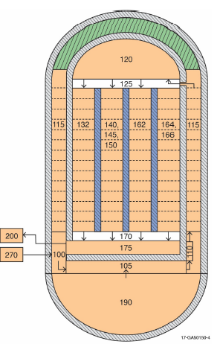
RPV Nodalization (Axial)
Upper and lower plenums
Plenums require FEM or FVM solvers
Five pipes constitute the core flow region
Two additional pipes represent helium gaps.
Place logo or company name here
Notes:
The pressure vessel is fairly complex. Helium enters the RPV and travels downward to the lower head. It then flows up to the core support structure (volume 105), to the upper plenum (volume 120) through the jacket shell and upcomer, then enters the core region, which consists of five main flow channels (132, 140, 145, 150, and 162). Flow then enters the lower plenum, which is represented as a branch, out to the cold duct (volume 200).
The upper and lower plenums are fairly complex in geometry. These regions are often the focal points for the phenomena that are important to HTGR PIRT’s. In the context of RELAP, which doesn’t model complex flow, it is only necessary to provide the forward and reverse loss coefficients in the branch cards for both hydrodynamic components.

Slide 9
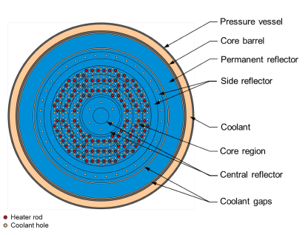
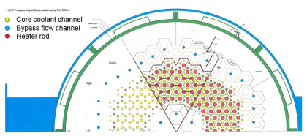
RPV Nodalization (Radial)
Heaters, ceramic block, and coolant channels smeared into concentric rings
Heat structures incorporate heater and ceramic material properties
Helium gaps btwn heaters and ceramic implemented as rings
Model assumes properties only differ in the radial direction
Place logo or company name here
Notes:
The core region is divided into concentric rings, alternating because heat structures and hydrodynamic volumes. Figure # on the top right shows how these concentric circles are configured, while Figure # on the bottom right shows how the core is actually configured.
There is a difference in how the fluid interacts with the solid structures between the two models. Whereas the actual core block has small channels spaced in certain intervals, the RELAP model combines the overall flow area of these small channels into five pipes. The heater channels, represented by the red dots in the upper corner figure, are incorporated into the RELAP heat structures, so the heat structures are “smeared” with both the heater and ceramic block material and have produce a uniform power distribution. Volumes 164 and 166 are incorporated to accommodate for the helium gaps that separate the heaters from the ceramic blocks.
This model assumes that the flow and thermal properties at each axial level are uniform circumferentially, implying that the only difference in properties should be found along the radial direction.

Slide 10
Procedural Guide 28 Test
Low Power (<350 kW) Lower Plenum Mixing Test
Notes:
I will next talk about the PG-28 test, which is a lower power outlet plenum mixing test.

Slide 11
General Description
Objective:
Place logo or company name here

Slide 12
RELAP5-3D Simulations
Notes:
I will now talk about the RELAP simulations that I performed. There were several iterations I performed.

Slide 13
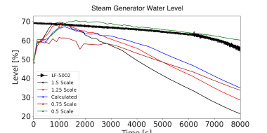
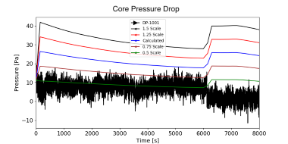
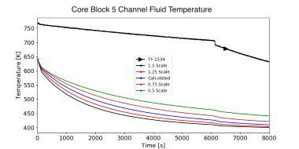
Initial Analysis (Summary)
Transient up to 8000 seconds was executed w/ SCS
Five MFRs tested
Heat up phase not modelled
System level results appear to be inconsistent
Lower MFR tends to be better for PCS heat balance and core DP
Pressure swings in first 100 seconds
Channel flow temp’s very inconsistent
What to try next?
MFRs around 0.5x that calculated
Adjust some of the forward pressure losses
Run some tests w/o SCS
Place logo or company name here
Notes:
My first round of tests incorporated, which is described in my summary I submitted to ANS, tests the full system up to 8000 seconds into the test. I chose this time because it was enough time to witness one full period where the mass flow rate was relatively constant, but also enough time to see what the impacts of increasing the mass flow rate in a step wise manner would be. I tested five separate flow rates ranging from 50% to 150% of what I calculated initially. I did not model the heat up phase initially, which was a mistake because both the pressures and temperatures within the primary system would fluctuate for about 100 seconds.
Based on the three plots I am presenting in this slide, it appears that the flow rate corresponding to half of what I initially calculated seems to present the best case. In fact, judging the heat removal based on the steam generator water level, it appears to almost hit the spot right on the nose. This lower mass flow rate is consistent with Aaron Epiney and his team concluded, in that the heat balance across the core suggests a significantly lower flow rate than what is estimated with the vendor graphs.
Some things did not quite make sense; one of them was the pressure drop across the core. Even though the lower mass flow rate matches pretty well with empirical pressure drop up to the time that flow rate is adjusted, the magnitude of that drop decreases when the velocity of the fluid increases.

Slide 14
Second Iteration Methods for Producing Decks
Initial Conditions
Experimental data mapped to R5 volumes and solids
Boundary Conditions
R5 is ran for 100 seconds to even out pressure differences
Custom TDJ implemented for circulator
Inadequate data to implement a PUMP card
Flow rate calculated via polynomial fitting w/ vendor data and empirical pressure data
Thermodynamic states obtained using EES
Seven unique decks
4 without the SG (1.25x, 1x, 0.75x, 0.5x) MFR
3 with SG (0.625x, 0.5, 0.375x) MFR
Place logo or company name here

Slide 15
Subsequent Tests
Initial Conditions
Experimental data mapped to R5 volumes and solids
R5 is ran for 100 seconds to even out pressure differences
Custom TDJ implemented for circulator
Flow rate calculated via polynomial fitting w/ vendor data and empirical pressure data
Thermodynamic states obtained using EES
Seven unique decks
4 without the SG (1.25x, 1x, 0.75x, 0.5x) MFR
3 with SG (0.625x, 0.5, 0.375x) MFR
Place logo or company name here

Slide 16
General Description
Initial Conditions
Experimental data mapped to R5 volumes and solids
R5 is ran for 100 seconds to even out pressure differences
Custom TDJ implemented for circulator
Inadequate data to implement a PUMP card
Flow rate calculated via polynomial fitting w/ vendor data and empirical pressure data
Thermodynamic states obtained using EES
Seven unique decks
4 without the SG (1.25x, 1x, 0.75x, 0.5x) MFR
4 with SG (1.25x, 1x, 0.75x, 0.5x) MFR
Place logo or company name here

Slide 17
Next Steps
What improvements can be done via simulations?
Notes:
It appears, based on the simulation results for this test as well as the PG-26 test performed by Epiney, that investigations need to be made that require either a QA process, or extensive simulations. Since going through the QA process is very expensive, I will only focus on what can be done via simulations to attempt to narrow down the possibilities for why there is large differences between the simulations and actual data. Specifically, I’ll talk about what can be done to improve boundary conditions for lower plenum simulations that don’t require going through the QA process.

Slide 18
Simulation Methods
Simulate PG-02 to find loss coefficients
MFR characterization test (Venturi)
Find loss coefficients for upper and lower plenums
Fix system pressure with TDV @ 200-0600
Place logo or company name here
Notes:
The first improvement I can think of is that the primary loop pressure losses need to be accurately accounted for. The pressure losses are important because through the ideal gas law, pressure is proportional to temperature. If pressure losses are properly accounted for, it narrows down the number of possibilities for why results differ.
Paul did a good job of accounting for most of them in his spreadsheet calculations, but he did not provide estimates for the two plenum regions. I’ll talk a little bit about both regions next.

Slide 19
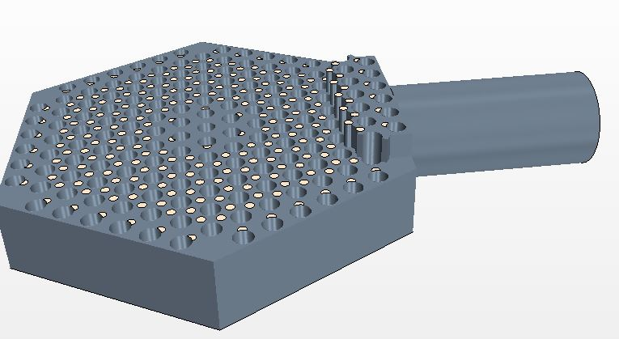
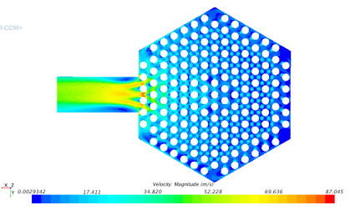
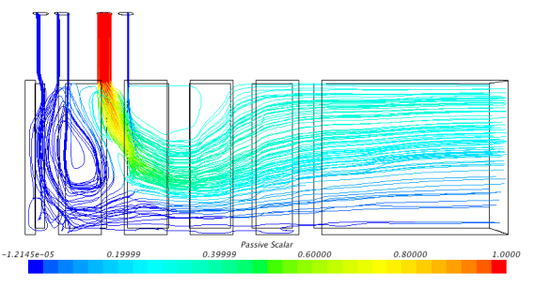
Notes:
I previously mentioned that the
To illustrate this point, I have provided two pictures that represent the RPV plenums. Figures # and # on the left show the fluid volume of lower plenum. As you can see, the support posts will force the fluid to exhibit wake-like behavior. However, if the inlet fluid jet velocity is sufficiently high enough, the fluid may strike the plenum floor, which would cause significant pressure losses. If this were the case, the total forward loss coefficient will be dependent on the Reynolds number.

Slide 20
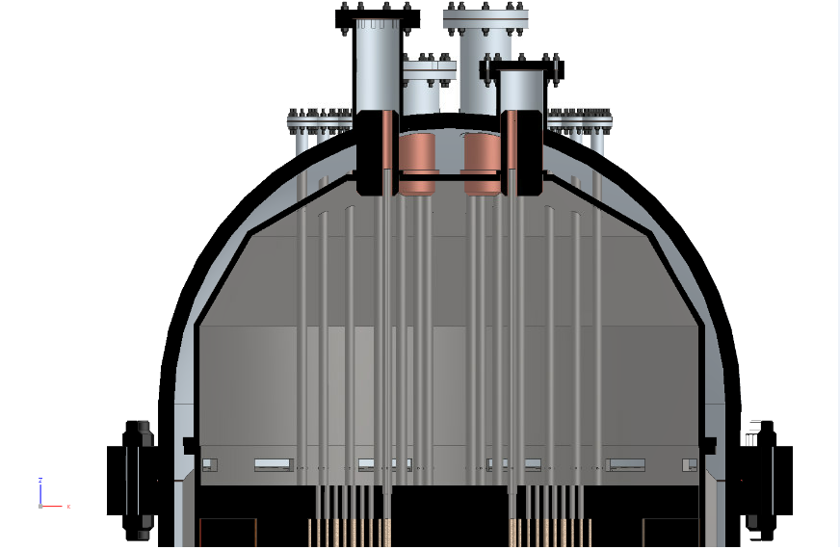
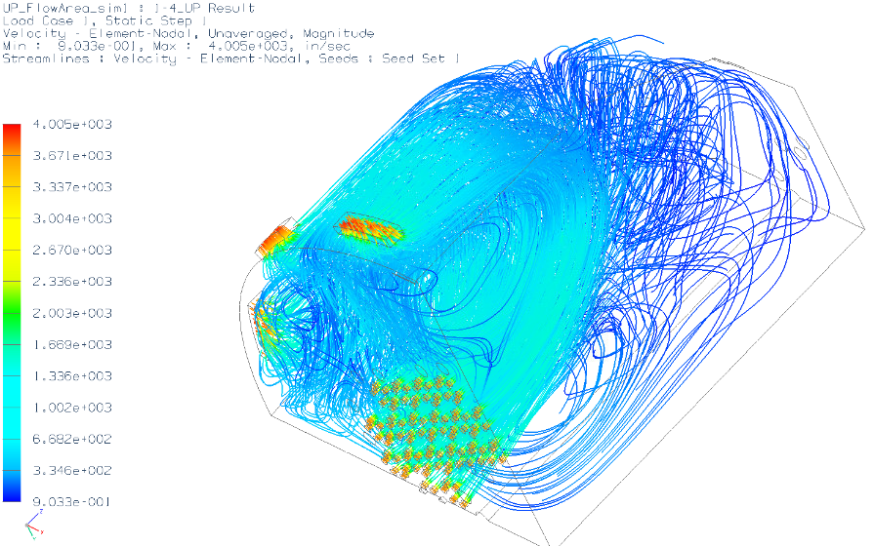
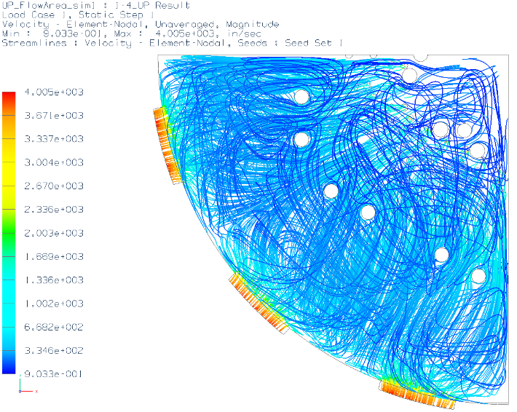
Notes:
The upper plenum isn’t as congested as the lower plenum, but there are some similarities in flow behavior. Flow enters the plenum through these little slit. Depending on the Reynolds number, there should be some swirling behavior, so the fluid will impinge upon the plenum shell and with itself (see Figure #). The fluid will then flow through the core channels, but there may be some impingement with the upper plenum floor, which would further cause swirling behavior.
The magnitude of this swirling behavior is dependent on the Reynolds number. If the flow is laminar, I would expect that the fluid would exit the slits and go straight to the core channels, particularly the bypass channels. I am inclined to believe that this is what occurred with the PG-28 test.

Slide 21
Simulation Methods
Simulate PG-02 to find loss coefficients
MFR characterization test (Venturi)
Find loss coefficients for upper and lower plenums (CFD)
Find surface roughness of material used
Fix system pressure with TDV @ 200-0600
Retest PG-26 and PG-28 heatup
Perform sensitivity study for core material properties
Verify solid/fluid average temperatures at each core block level
Look into coupling MOOSE w/ STAR upper plenum model
Place logo or company name here
Notes:
The preferable method to find both loss coefficients is to perform CFD studies for the PG-02 characterization test, which utilizes orifices to estimate the mass flow rate. In other words, we know the mass flow rate for this test, and the expected pressure losses, so I would expect a good estimate for the loss coefficients as a function of the Reynolds number. This test can also be used to verify the other pressure losses in the primary system.
The main problem, however, is ensuring that the fluid jet temperatures are accurate. Unfortunately, the HTTF is not equipped with thermocouples at the channel outlets that would be helpful to determine both the temperature profile, which can be used to verify the accuracy of the temperatures at the 170 branch.
What can be done is verifying that the average fluid and solid temperatures at each core block level are reasonably in line with what is determined experimentally. I say average, because based on experimental data, there are hot spots within the core, and the current R5 model is not equipped to model that kind of physics. If this does not work, either a sensitivity study on the material properties can be attempted to try to short up differences, or some sort of coupling with MOOSE and STAR-CCM can be done to actually model the hot spots.

Slide 22
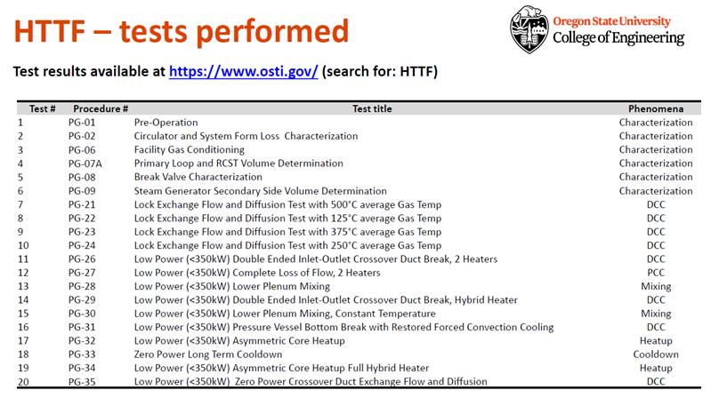
Additional Resources for HTTF Tests
Notes:
I posted this slide to provide the audience an additional resource by which they can see what tests have been performed at the HTTF, as of fall 2019. Currently, there are no additional tests planned.

Slide 23
References
Woods, B. G. (2018). OSU High Temperature Test Facility Design Technical Report, OSU-HTTF-TECH-003-R2.
Woods, B. G. (2019). PG-35 Zero Power Crossover Duct Exchange Flow and Diffusion Test 1, OSU-HTTF-TAR-028-R0.
K. Brumback, “Effect of Initial System Temperature on Initiation of Natural Circulation during a Depressurized Conduction Cooldown Event in the High Temperature Test Facility.,” Thesis, Oregon State University, 2020.
Louria, S. (2019). Instrumentation Plan for the OSU High Temperature Test Facility, OSU-HTTF-TECH-002-R4.
Epiney, A. (2020). RELAP5-3D Modeling of High Temperature Test Facility Test PG-26, INL/EXT-20-59902.
‌DOE/ID-Number (inl.gov)
Notes:
[1] TECH-001
[2] TECH-002
[] Paul’s INL Document
[] Aaron’s PG-26 Test
And here are the references I used as part of my analysis. I would like to give special thanks to my advisor, Dr. Gutowska, for providing me the resources to understand that working mechanisms of the OSU HTTF, as well as INL scientist Aaron Epiney for helping explain RELAP and the HTTF deck as well as providing the scripts for building the input decks, and processing the strip files into custom plots. Last, I would like to thank Dr. Paolo Balestra for his guidance about how to use MOOSE and Pronghorn during my internship at INL.

Slide 24
Questions?
Contact email: halstedj@oregonstate.edu

